Slide 1
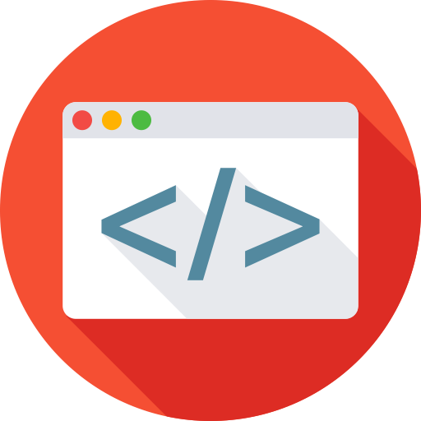


Front end applications
By Elham Jaffar

Slide 2
Click event issue
Multiple click or event listeners inside the for loop will produce a problem:
All listeners will be attached to the same DOM (Document Object Model) element.
Let’s take an example (City Project) to understand this issue and how to fix it ?

Slide 3
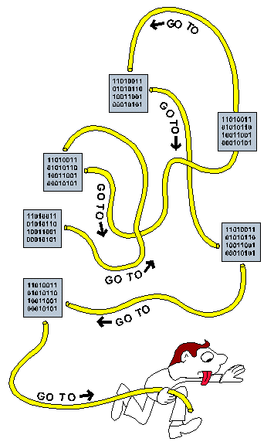
Spaghetti Code
Spaghetti code is a pejorative phrase for unstructured and difficult to maintain source code, broadly construed.

Slide 4
Promises

Slide 5
Promise
The Promise object represents the eventual completion (or failure) of an asynchronous operation, and its resulting value.
Promise Usage
Notes:
http://es6-features.org/#PromiseUsage

Slide 6
Promise vs call back
A callback is a function that is passed to an another function. A callback may or may not be executed asynchronously.
A Promise is a object which takes a callback and executes it asynchronously and it returns a promise object.
Notes:
http://es6-features.org/#PromiseUsage

Slide 7
promise?
Let’s consider that as try catch wrapper that will finish in unpredictable time.
Notes:
http://es6-features.org/#PromiseUsage

Slide 8
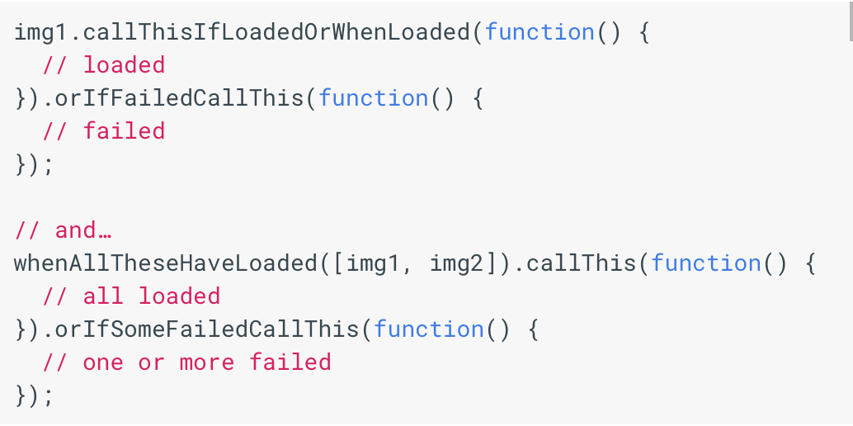
Promise?
A promise can only succeed or fail once. It cannot succeed or fail twice, neither can it switch from success to failure or vice versa.
If a promise has succeeded or failed and you later add a success/failure callback, the correct callback will be called, even though the event took place earlier.
Notes:
http://es6-features.org/#PromiseUsage

Slide 9
Promise?
A promise can be:
fulfilled - The action relating to the promise succeeded
rejected - The action relating to the promise failed
pending - Hasn't fulfilled or rejected yet
settled - Has fulfilled or rejected
Notes:
http://es6-features.org/#PromiseUsage

Slide 10
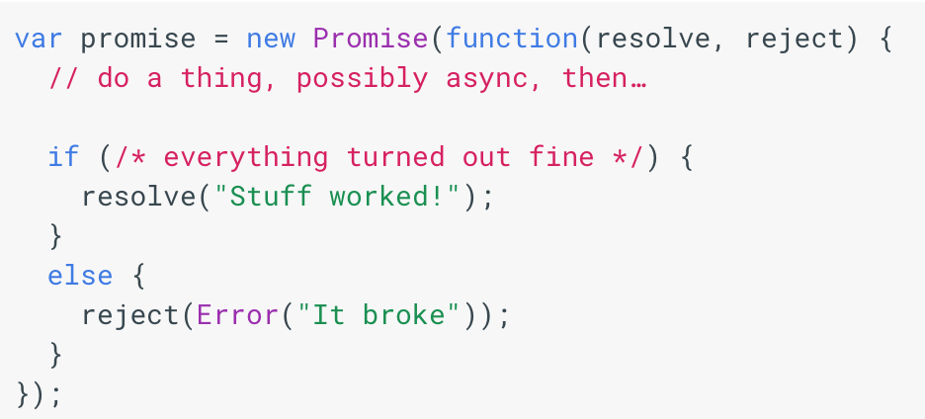
Promise syntax
The promise constructor takes one argument, a callback with two parameters, resolve and reject.
Notes:
http://es6-features.org/#PromiseUsage

Slide 11
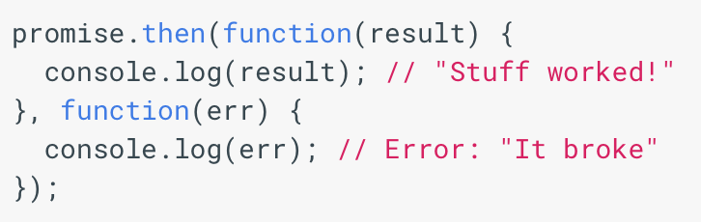
Promise and then
then() takes two arguments, a callback for a success case, and another for the failure case. Both are optional, so you can add a callback for the success or failure case only.
Notes:
http://es6-features.org/#PromiseUsage

Slide 12
Ajax

Slide 13
AJAX Request
What does AJAX stand for?
Asynchronous
JavaScript
And
XML (Extensible Markup Language)
AJAX allows web pages to be updated asynchronously by exchanging data with a web server behind the scenes. This means that it is possible to update parts of a web page, without reloading the whole page.

Slide 14
How Does AJAX Work ?
send
Internet
receive
Create XMLHttpRequest Object
Send HttpRequest
Process HttpRequest
Create a Response
Browser
Server
receive
send
Process the returned data using JavaScript
Update page content
Send data back to the browser (XML, JSON, HTML)

Slide 15

Important points about ajax
AJAX is not a programming language.
AJAX just uses a combination of:
A browser built-in XMLHttpRequest object (to request data from a web server)
JavaScript and HTML DOM (to display or use the data)
AJAX requests sometimes require authentication and sometimes not.
Advantages of AJAX:
Reduce the traffic travels between the client and the server.
Response time is faster so increases performance and speed.

Slide 16
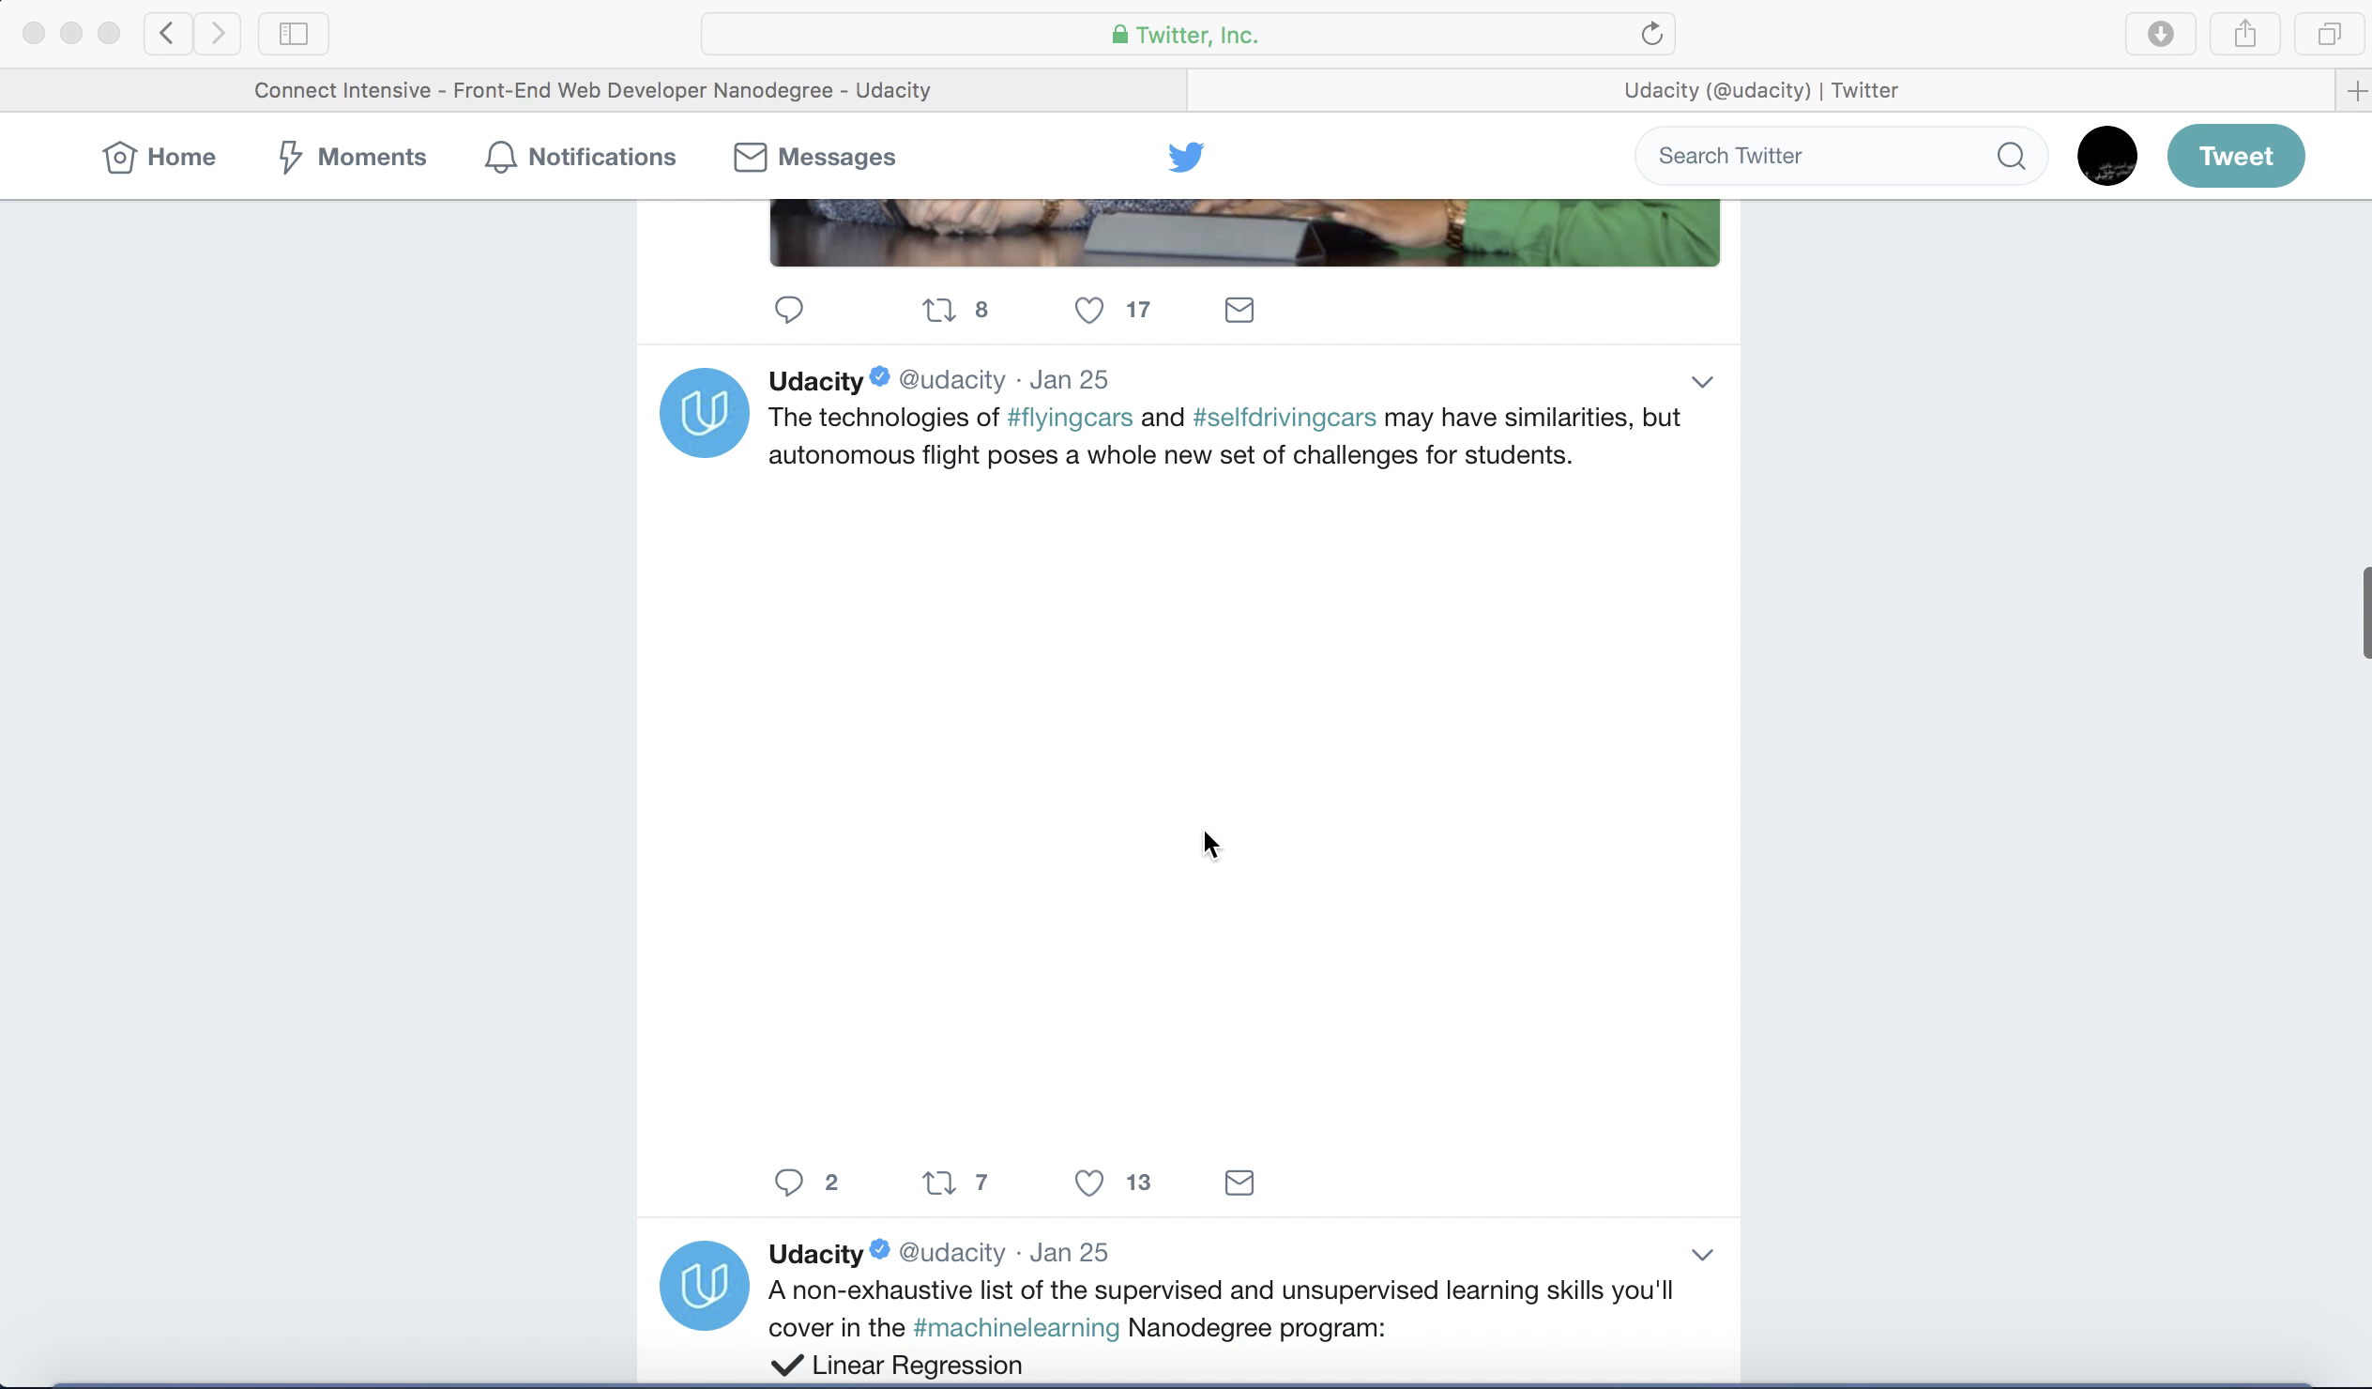

Slide 17
JQuery
It is a JavaScript Library that simplifies JavaScript programming.
It has number of AJAX methods:
Method | Description
$.ajax() | Performs an async AJAX request
$.getJSON() | Loads JSON-encoded data from a server using a HTTP GET request
$.ajaxError() | Register a handler to be called when Ajax requests complete with an error.
Read More about getJSON()

Slide 18
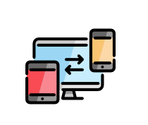
practice
Open your browser and type the below path:
https://twitter.com/udacity
Open the developer tools
Start recording the network and scroll down to load more tweets
Stop recording and start analyzing the traffics
Notes:
Tweets?include has item_html

Slide 19
Jasmine Exercise
Click Here !
Notes:
https://www.w3resource.com/javascript-exercises/javascript-function-exercise-6.php

Slide 20

Remember that we are here to help you
All you have to do is ASK!
Thank you for Attending

